Slide 1
Paris Place Apartments Medical Students ONLY Program
Apartment Location
2113 N. Carolina St.
Saginaw, MI 48602
Contact Information
Phone 989-372-0311
parisplaceapartments@gmail.com

Slide 2
Hassle Free Housing
At The Paris Place you don’t have to worry about your housing needs. Let us at Paris make your stay comfortable and hassle free.
You will be in a comfortable, safe, secure and central location with Saint Mary's, Covenant and Synergy (CMU Medical) located approximately 5 minutes away
Live in a comfortable spacious apartment with your choice of a 2 bedroom/1 bathroom apartment. All apartments completely remodeled with brand new carpet, flooring, kitchen cabinets, bathrooms, Laundry room and all appliances.
Many conveniences are located within
walking distance of the complex, such as bars, restaurants, malls and much more.

Slide 3
Guest Room Amenities at The Venetian
Free Wi-Fi Internet
Free cable television
Free Water
Free Heat
Free Electric
Fully Furnished
Coin Operated washer and dryers on site.
Safe/Secure with 24 hour surveillance
Located 2.3 miles from Saint Mary’s, and 1.3 miles from Synergy (CMU) and Covenant Hospital
Its simple, pack your bags and move in.
Excludes: computer
Bed linens, towels, kitchen utensils

Slide 4
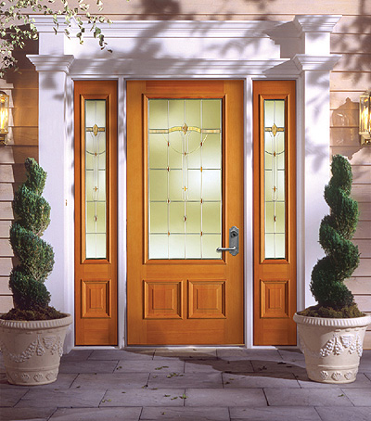
Right Outside your door
Fashion Square Mall
Restaurants. Supermarkets, Hair Salons etc.
Minutes away from Banks & ATMs
5 minute drive from the YMCA of Saginaw a premier gym
5 minute drive from Synergy Medical (CMU)
5 minute drive to nearest grocery store
5 minute drive to Old Town Saginaw with an exciting Nightlife and great restaurants

Slide 5
Our Rates (Fully Furnished per person)
2 Bedroom/1 Bath Apartment
$300 Security Deposit
$800 per month/ per person (utilities included)
Fully Furnished Includes:
Bed(Full) (Linens not included)
Futon/Couch
Dinner table w/ 4chairs
Refrigerator
Stove Top Oven
Microwave
Toaster
Shower Curtain
TV Stand with 28”-32” Flat screen TV
=

Slide 6
Just unpack your bags and welcome to THE PARIS PLACE APARTMENTS!
Please contact us today with any questions:
Phone : 989-372-0311 parisplaceapartments@gmail.com

